Slide 1
HighRadius Business Track Project
Submitted in the partial fulfillment for the award of the degree of
BACHELOR OF ENGINEERING
IN
Computer Science Engineering- Mobile Computing
Submitted by:
Anand Svarup Bhatia
19BCS4257
Under the Supervision of:
Divya Jha
Department of AIT-CSE
DISCOVER . LEARN . EMPOWER

Slide 2
Outline
Introduction to Project
Problem Formulation
Objectives of the work
Methodology used
Results and Outputs
Conclusion
Future Scope
References

Slide 3
Introduction to Project
HighRadius Business Track Internship was internship program to skill students to work in professional environment and learn consultancy skills.
This internship included:
Case-Study
Excel Function Assignments
Data interpretation
SQL Assignments

Slide 4
The Three-month internship was completed with High radius teaching important life skills and lessons such as:
• Teamwork
• Critical thinking
• Time management
• Workload management
• Creativity
• Professional writing

Slide 5
Problem Formulation
Key performance area / Key Job Activities:
1. Consulting
2. Group Discussions
3. Business Case studies
4. Collaborations
5. Brain Storming

Slide 6
Problem Formulation
Case-Study included following Skills to be implemented:
Market Sizing.
Guesstimation.
Q-Matrix Analysis.
Analyzing statistics.
Detecting issues and investigating ways to resolve them.
Assessing the pros and cons of possible strategies.
Conducting research, surveys and interviews to gain understanding of the business

Slide 7
Objectives of the Work
Understanding market sizing and potential calculation of the product
Understanding customers needs and requirements
Analyzing and interpreting data
Solution finding
Brainstorming
Implementing agreed solutions
Developing and implementing new procedures or training.
Compiling and presenting information orally, visually and in writing.

Slide 8
Methodology used
Tools that were majorly used were:
1. Microsoft Office PowerPoint
2. Excel.
3. MS Word
4. MY SQL
5. Google Sheets
6. Google Docs
7. G-Suite

Slide 9
Methodology

Slide 10
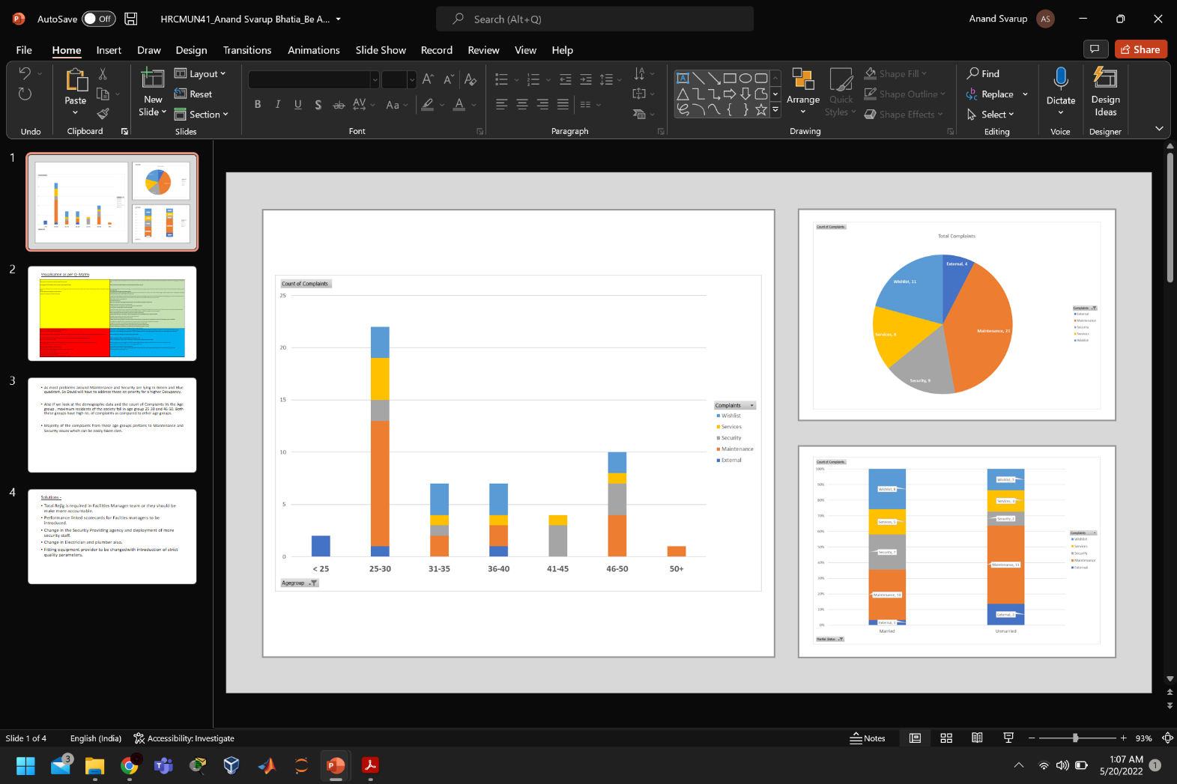
Results and Outputs

Slide 11
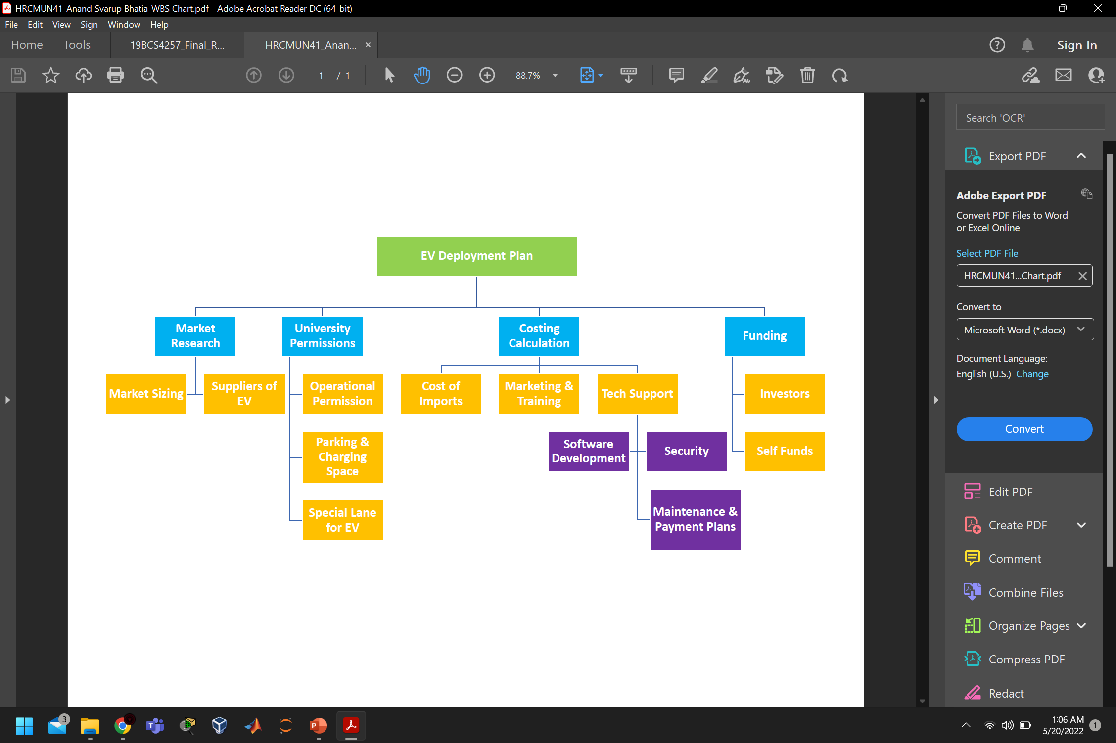

Slide 12
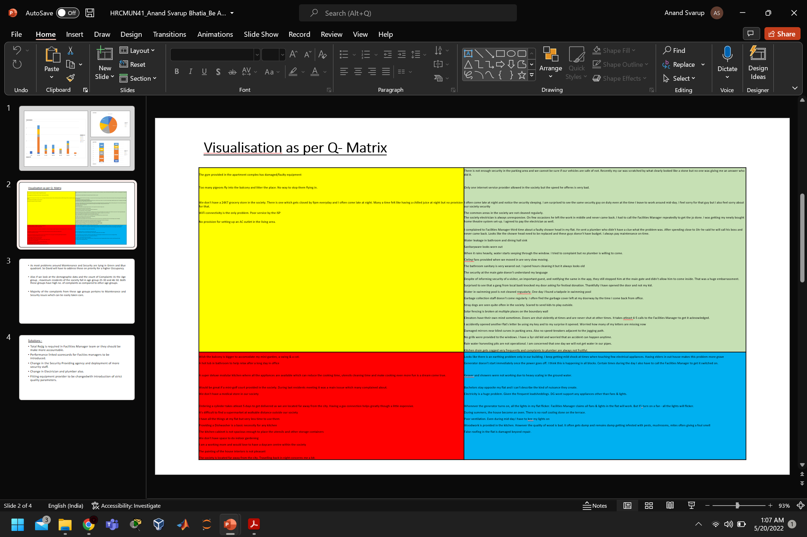

Slide 13
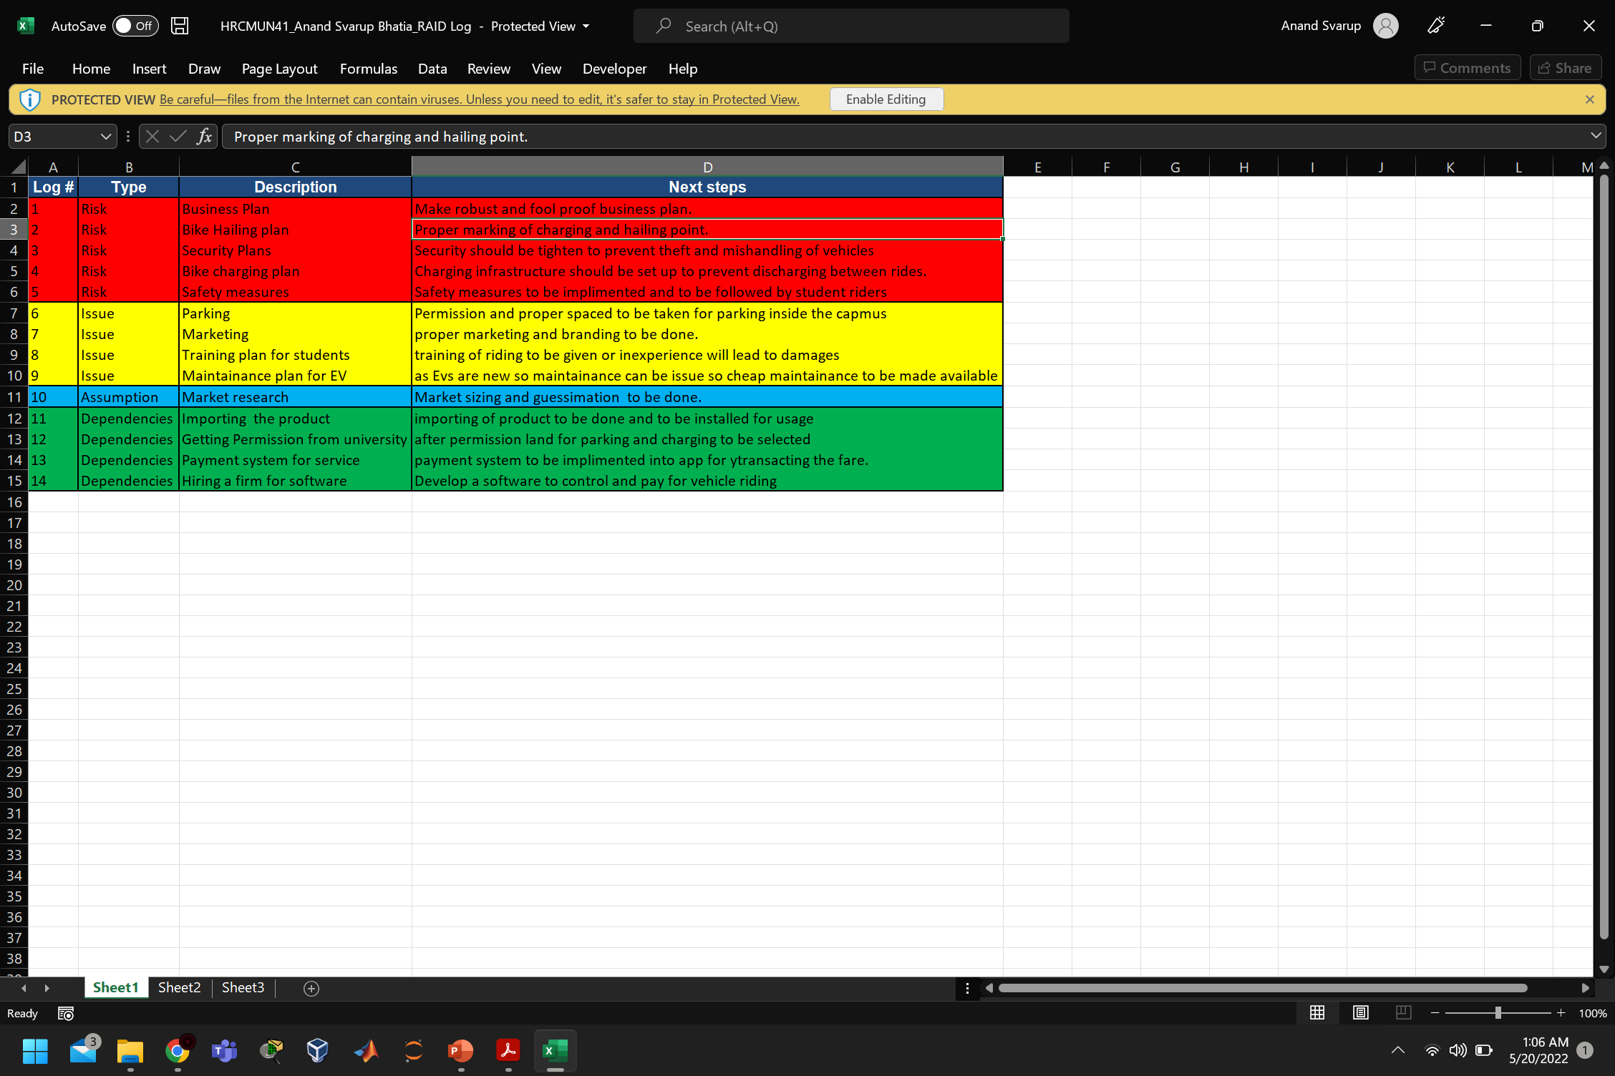

Slide 14
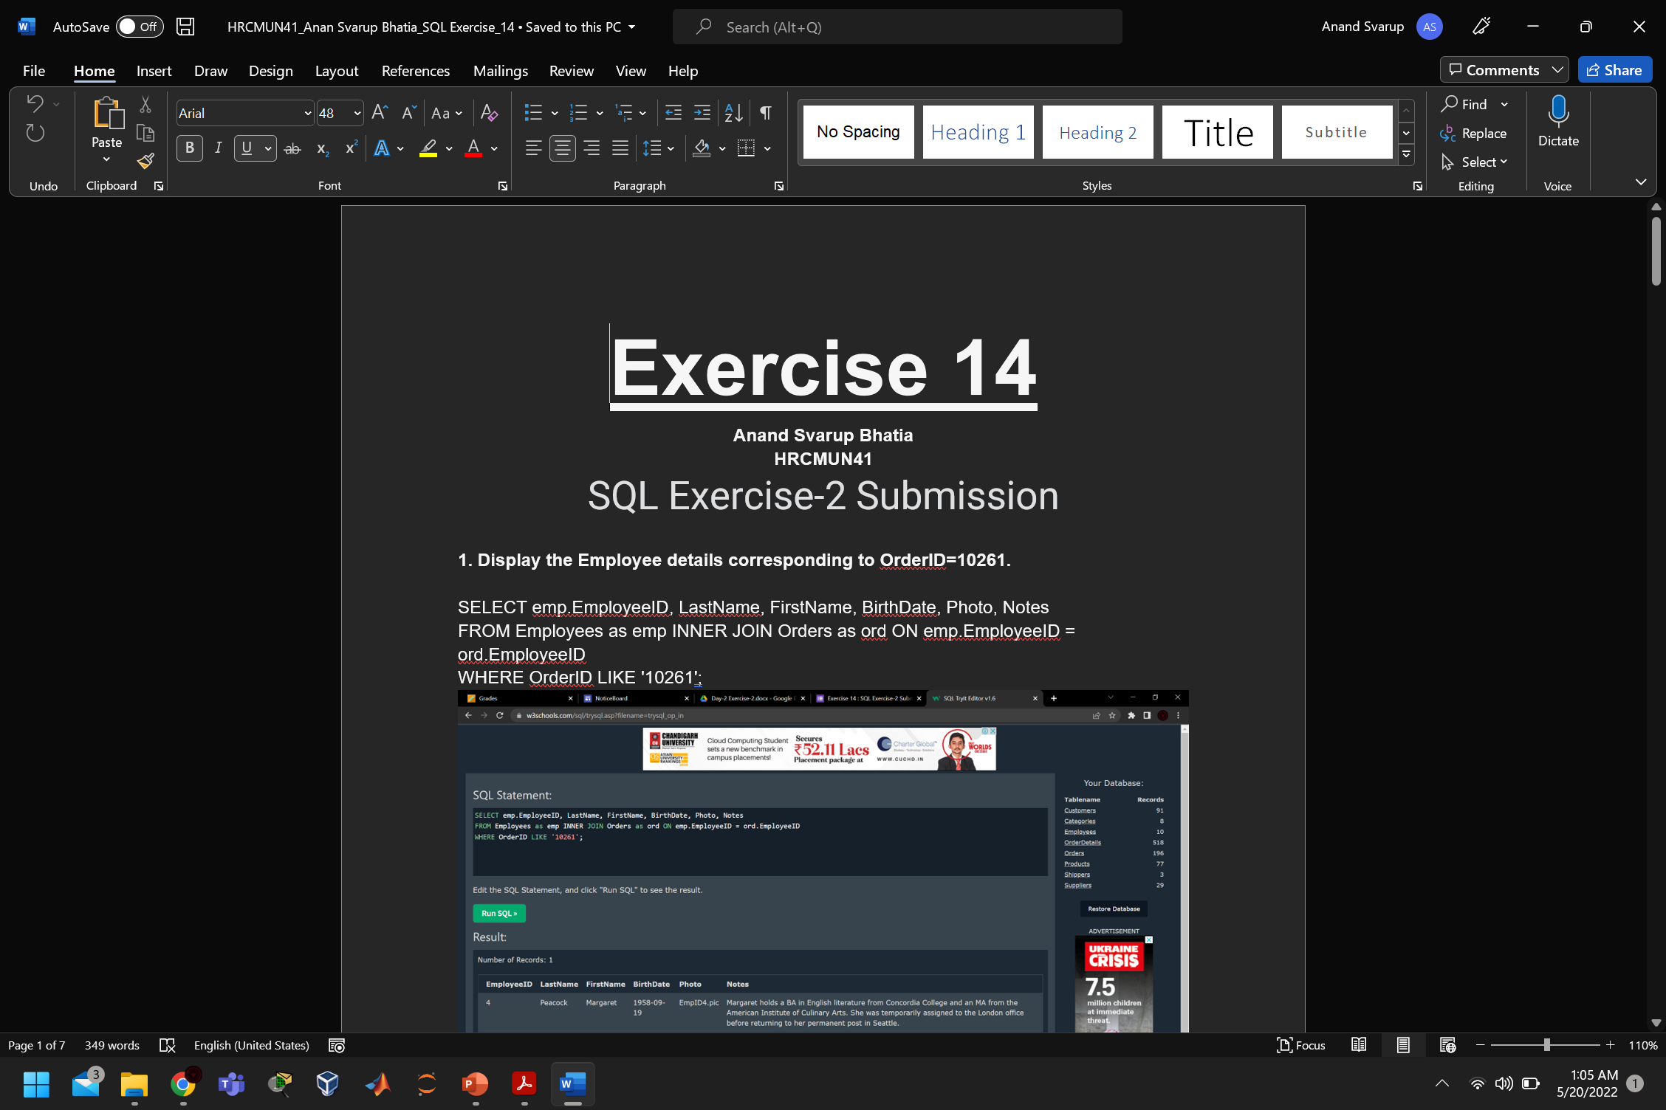

Slide 15
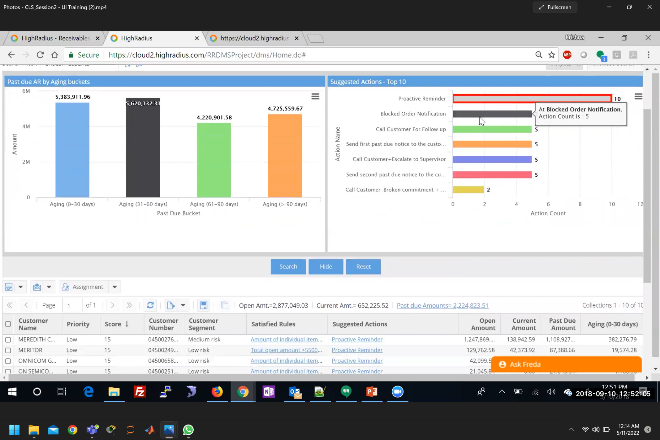

Slide 16
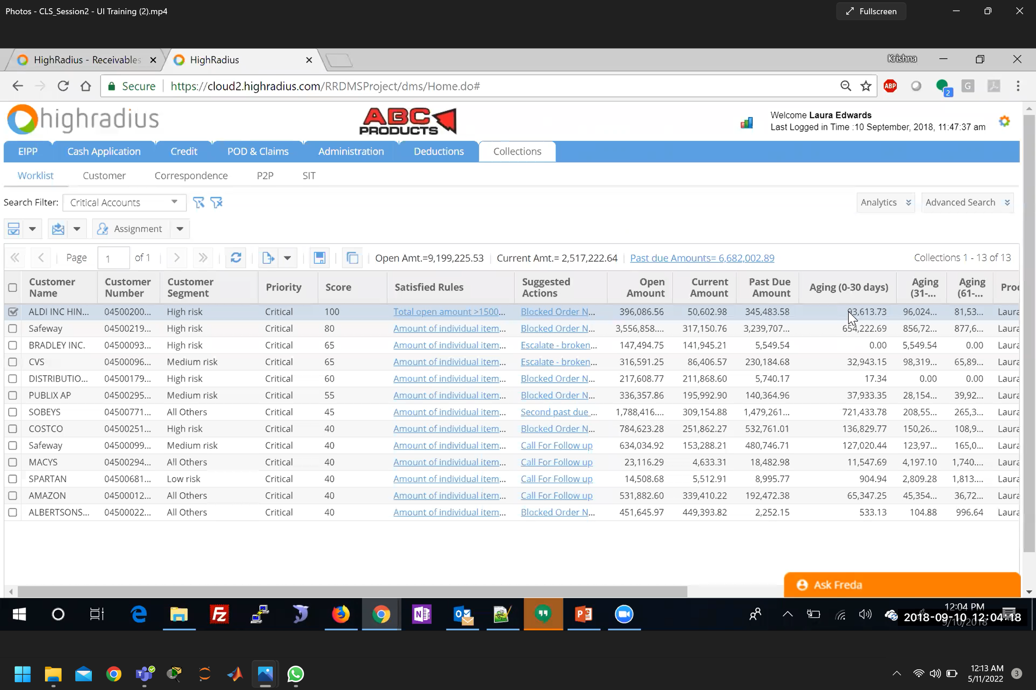

Slide 17
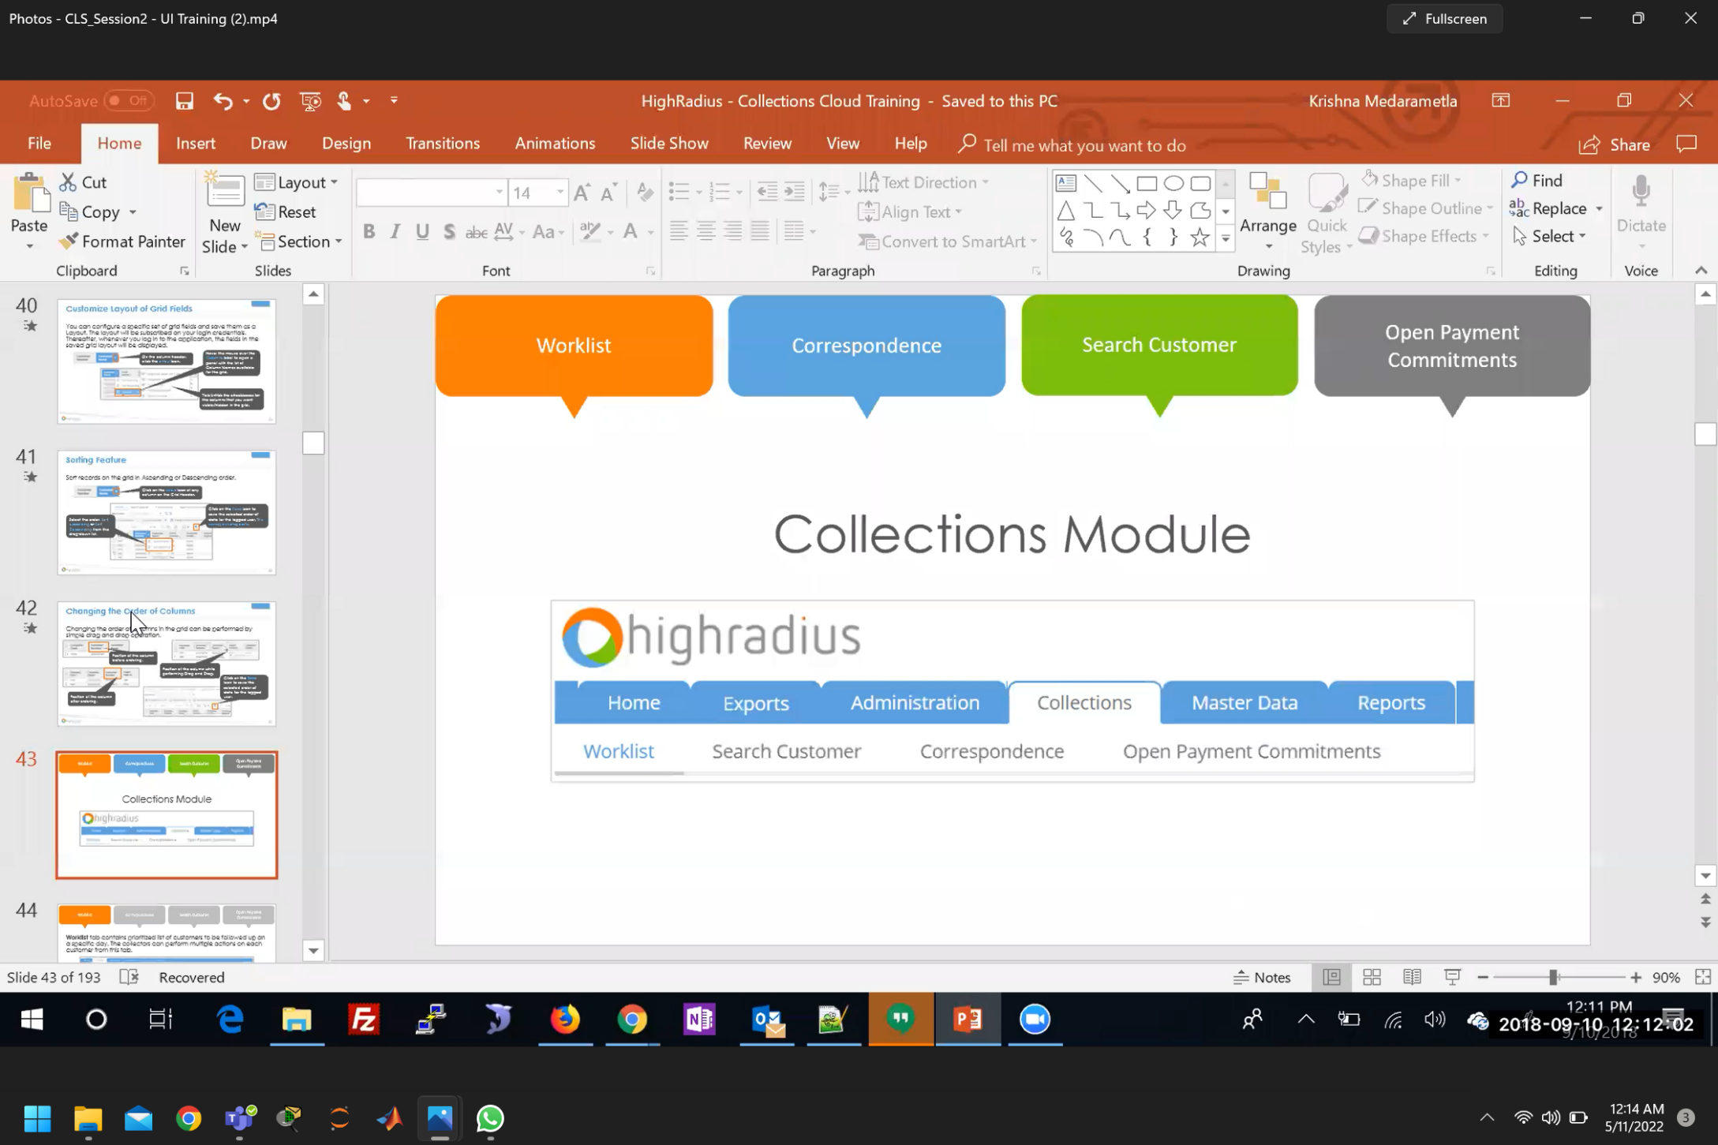

Slide 18
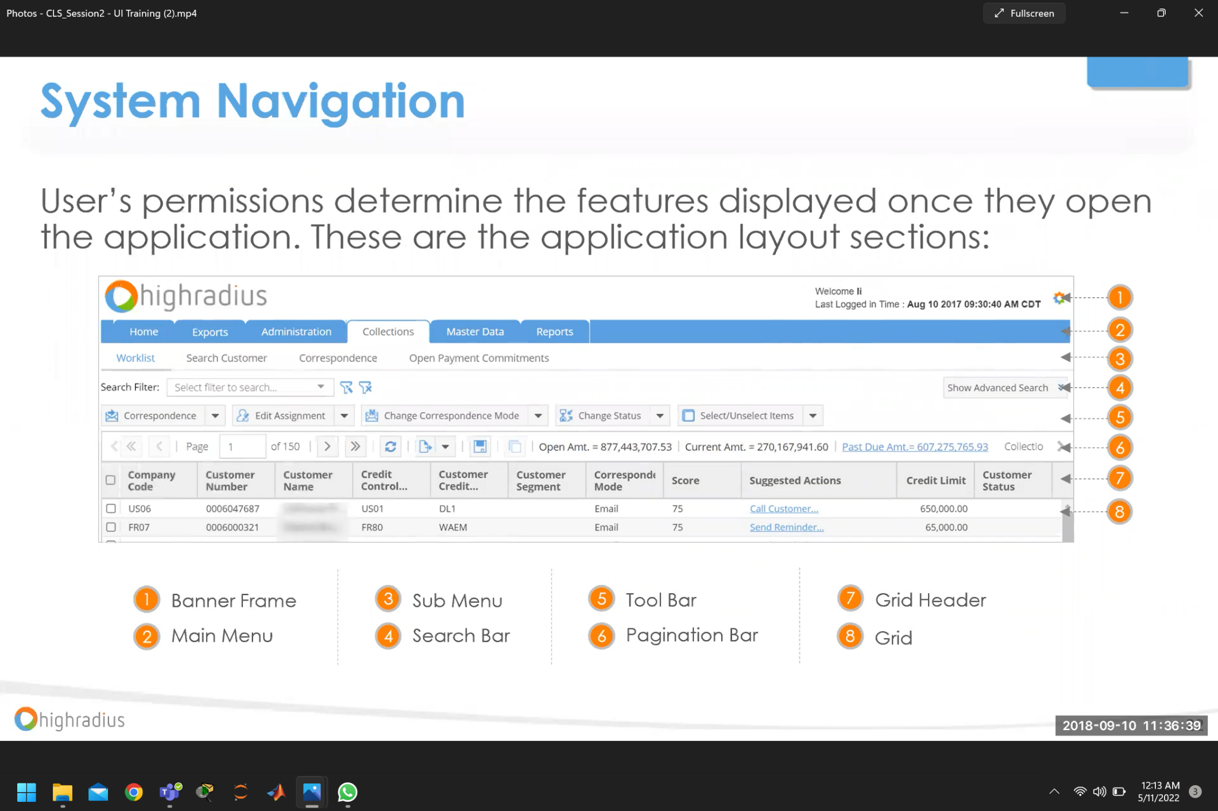

Slide 19
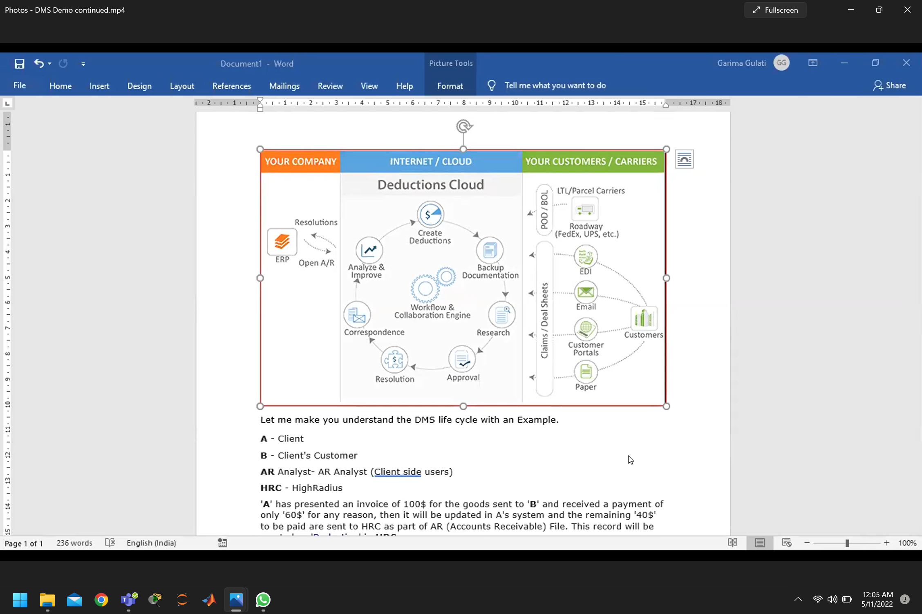

Slide 20
Conclusion
The Three-month internship was completed with High radius teaching important life skills and lessons such as:
• Teamwork
• Critical thinking
• Time management
• Workload management
• Creativity
• Professional writing
Also, few industry skills were:
• G suite operation
• SQL operations
• Brain storming
• Supply chain management
• Negotiation skills
• Data analysis and management
Along with these day-to-day schedules made us all working in business track cooperate ready and always ready to take any challenge given at us.

Slide 21
Future Scope
Detailed knowledge of HRC products to be taken
Hands on training to be taken
More skills to be developed with respect to Consultancy
Client Dealing to be done with enhanced problem solving
More discipline to be maintained in formal work
Time and pressure management to be strengthened

Slide 22
References
7 habbits of life by steve covey: https://www.franklincovey.com/the-7-habits/
• Business ethics: https://corporatefinanceinstitute.com/resources/knowledge/other/business-ethics/
• Excel tips & Tricks: https://blog.hubspot.com/marketing/how-to-use-excel-tips
• G-suite : https://workspace.google.com/intl/en_in/
• Group Discussion: https://www.javatpoint.com/group-discussion#:~:text=Group%20Discussion%20or%20GD%20is,group%20represents%20his%2Fher%20perspective.
• Professional Ethics: https://en.wikipedia.org/wiki/Professional_ethics
• Interview Skills: https://www.indeed.com/career-advice/interviewing/interview-skill
• Business Principles: https://www.indeed.com/career-advice/career-development/fundamental-business-principles
• Email Writing: https://www.ilac.com/10-tips-on-how-to-write-a-business-email-in-english/
• Business Communication : https://www.nextiva.com/blog/what-is-business-communication.html#:~:text=Business%20communication%20is%20the%20process,organizational%20practices%20and%20reduce%20errors.

Slide 23
References (Cont.)
• SQL: https://www.w3schools.com/sql/default.asp
• Excel : https://support.microsoft.com/en-us/office/excel-functions-alphabetical-b3944572-255d-4efb-bb96-c6d90033e188
• B2B VS B2C : https://www.salesforce.com/eu/blog/2021/11/b2b-vs-b2c-ecommerce-difference.html#:~:text=B2B%20stands%20for%20'business%20to,B2C%20ecommerce%20targets%20personal%20consumers.
• Highradius: https://www.highradius.com/resources/ebooks/

